Slide 1
Running with Scissors
Notes:
https://en.wikipedia.org/wiki/Scissors#History
https://gizmodo.com/the-extraordinary-evolution-of-the-most-common-tool-sc-1617641302
https://idioms.thefreedictionary.com/run+with+scissors
https://healthandfitnesshistory.com/explore-history/history-of-running/
https://www.vampiretools.com/blog/now-something-completely-different-scissors-superstitions/

Slide 2
Running with Scissors
ADVANCED
Notes:
Welcome to Running with Scissors

Slide 3
Agenda
...You will build a cookbook in a test-driven approach with InSpec, extract the InSpec tests/controls into a InSpec profile, use the InSpec profile to test another cookbook, use the InSpec profile to scan non-nodes (agent-less), and finally use the InSpec profile with the Chef Audit cookbook to run on nodes (chef-client agent).

Slide 4
What is Advanced?
My definition of advanced does not mean you are required to understand a large body of concepts before coming into this workshop. So when I have made an assumption about
Advanced to me means that with a clear explanation you are able to reason well enough to mentally place this concept into the landscape of the other concepts necessary to complete the work.
In my experience, this often means you are already familiar with concepts and operations making the operation of understanding quicker.

Slide 5
You are...
interested in learning more about Chef, InSpec, and Habitat.
written Chef resources within a recipe in a cookbook

Slide 6
You are...
interested in learning more about Chef, InSpec, and Habitat.
written Chef resources within a recipe in a cookbook
tested a recipe with Test Kitchen

Slide 7
You are...
interested in learning more about Chef, InSpec, and Habitat.
written Chef resources within a recipe in a cookbook
tested a recipe with Test Kitchen
written a cookbook with a dependency on other cookbooks

Slide 8
You are...
interested in learning more about Chef, InSpec, and Habitat.
written Chef resources within a recipe in a cookbook
tested a recipe with Test Kitchen
written a cookbook with a dependency on other cookbooks

Slide 9
Introduce Ourselves
Name
Where you work
The best part of your work and the most challenging part of your work
A favorite hobby or past time as a child
Why you came to ChefConf and what you want to get out of it
Notes:
Before we get started, I think it is important to take a moment to introduce ourselves to one another.
Instructor Note: Often times with larger, in-person groups I prefer to have the individuals perform this introduction one-on-one. Having people leave their seats and greet as many people as they can during the time allotted. I often feel this works better as it removes the pressure from the single individual to introduce themselves in a way that is presenting themselves and not actually greeting people. When Online, I create a pre-defined order, announce that order, and then invite a person to speak, thank them when they are done.

Slide 10
Lord Vader, the DEATH STAR is complete. We scienced the shit out of it!
Presented by ....

Slide 11

Lord Vader, the DEATH STAR is complete. We scienced the shit out of it!
Did anyone write tests? I don't want any vulnerabilities!
Franklin Webber
@burtlo
Notes:
My name is Franklin Webber. I work on the Training Team at Chef. In that time I have delivered a number of classes in-person and online. I have delivered workshops at previous ChefConfs and Chef Community summits. I have also developed a lot of training materials for Learn Chef Rally.

Slide 12




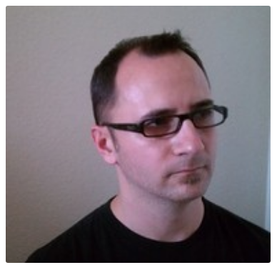
Slack - #running_with_scissors
Nick Rycar
Galen Emery
@nrycar
@galen
Damien O'Neal
Ned Harris
@Damien
@ned
Notes:
The following individuals are also here to facilitate your learning today. They are all very capable Chef PR actioners that can help answering your questions, troubleshoot your code and engage in discussions with you.

Slide 13
Expectations
Ask Us Anything: It is important that we answer your questions and set each other on the path to be able to find more answers.
Notes:
All throughout this training I strongly encourage you to ask questions whenever you do not understand a topic, an acronym, concept, or software. By asking a question you better your learning and often times better the learning of those with you in this training. Asking questions is a sign of curiosity that we want to encourage and foster while we are here together.

Slide 14
Expectations
You will leave this workshop with the ability to:
identify the various concerns within a recipe/cookbook
develop InSpec tests for a service/application
create InSpec profiles that provide re-use in cookbook testing
setup the execution of InSpec profiles on every node converge

Slide 15
Schedule
9:00 - 9:50 – Introductions and Code Review
10:00 - 10:50 – First Web Service
11:00 - 11:50 – Second Web Service
12:00 - 13:00 – LUNCH
Notes:
I have broken the day out in the following sections. Currently we are in the introduction section and we will finish this section with a code review exercise. We will then break for 10 minutes and then return and start work on our first challenge of testing and refactoring the first web service. We will repeat this activity for a second web service - reinforcing our skills and/or applying new techniques. Then we will break for lunch.

Slide 16
Schedule
12:00 - 13:00 – LUNCH
13:00 - 13:50 – Re-use with InSpec Profiles
14:00 - 14:50 – Third Web Service
15:00 - 15:50 – Audit Cookbook
16:00 - 16:30 – A Web Service in Habitat
16:30 - 16:50 – Summary / Wrap up
Notes:
After working with that second exercise you will begin to notice some patterns and repetition within your work. After lunch we will explore techniques to reduce this repetition. And then we will look at a third cookbook that will have you apply similar techniques and patterns again. After seeing these three examples its time for us to explore how these cookbook developments practices can aid us in validating the systems we provision and configure in our integration and production environments. Finally, we will take a moment to explore how the application cookbooks we have developed is a pattern that appears in the world of Habitat. Lastly, during our wrap-up I will take a moment to provide you resources to further reinforce the work you did today and expand your skills.

Slide 17
Agenda of a Challenge
Overview and Concepts (15 minutes)
Outline the challenge that you are about to face and define success criteria
Define the tools and techniques you are going to use to solve the problem
Exercise (25 minutes)
During this time you will solve the challenge with all of us supporting one another
Review (10 minutes)
Demonstration and review the techniques and answer questions
Notes:
During the workshop I want to give you as much autonomy as possible to explore the material presented. Learning in this manner can be challenging if you are expecting to be told exactly what code to write to solve the problems. I will start by introducing the challenge and then present the concepts that will assist you in overcoming this challenge. Then it will be your turn to complete the challenge applying these concepts in this specific scenario.
You are not alone. I encourage you to work together to solve these challenges together. Myself and the other facilitators are here to help you if you feel uncertain about what you are suppose to accomplish or how to accomplish it. Together we will get through these exercises.

Slide 18
Remotely
Locally
Login to the a remote workstation:
user: chef
password: Cod3Can!
Workstations:
https://goo.gl/nmp2pV
System Requirements:
* Chef Development Kit (2.5.3)
* Docker (18.03.1-ce)
* kitchen-dokken (2.6.7)
Clone/download:
https://github.com/chef-training/running_with_scissors
Notes:
There are two ways to engage with the content. The preferred path for those of us here to support you is on a remote workstation. The link provided has each of your names listed and an instance available that you are able to connect to and use. It has all the tools and the content that was tested against it.

Slide 19
Challenge: Code Review
Notes:
Before we start logging into systems and working with code you are going to perform an exercise where we view the code away from the context of it being executed. The concepts we explore during this exercise will appear again and again in all three of the web service cookbooks you use today and likely your time working with Chef and InSpec.

Slide 20
Challenge: Code Review
Overview
Concepts
Exercise
Review
Notes:
Code review is an examination of source code. It is a useful process that helps us ensure the code we write is correct and increases its quality.

Slide 21
First Microservice
Notes:
The first cookbook has a single default recipe which setups a web service.

Slide 22
Viewing the Contents of the ruby_service
> tree cookbooks/ruby_service
cookbooks/ruby_service
├── files
│ └── specter.zip
├── recipes
│ └── default.rb
├── templates
│ ├── service.erb
│ ├── start.sh.erb
│ └── stop.sh.erb
│

Slide 23
First Service's Default Recipe
~/cookbooks/ruby_service/recipes/default.rb
directory '/srv'
package 'unzip'
cookbook_file '/srv/specter.zip' do
source 'specter.zip'
notifies :run, 'execute[extract_site]', :immediately
end
execute 'extract_site' do
cwd '/srv'
command 'unzip specter.zip'
not_if { File.exist?('/srv/specter') }
action :nothing
end

Slide 24
First Service's Default Recipe
~/cookbooks/ruby_service/recipes/default.rb
package %w[git-core zlib zlib-devel gcc-c++ patch readline readline-devel libyaml-devel libffi-devel openssl-devel make bzip2 autoconf automake libtool bison curl sqlite-devel]
remote_file '/tmp/ruby-2.5.1.tar.gz' do
source 'https://cache.ruby-lang.org/pub/ruby/2.5/ruby-2.5.1.tar.gz'
end
execute 'extract ruby' do
cwd '/tmp'
command 'tar -xvf ruby-2.5.1.tar.gz'
not_if { File.exist?('/tmp/ruby-2.5.1') }
end

Slide 25
First Service's Default Recipe
~/cookbooks/ruby_service/recipes/default.rb
execute 'configure, make and install ruby' do
cwd '/tmp/ruby-2.5.1'
command './configure && make && make install'
not_if { File.exist?('/usr/local/bin/ruby') }
end
execute 'install bundler' do
command '/usr/local/bin/gem install bundler'
not_if { File.exist?('/usr/local/bin/bundle') }
end

Slide 26
First Service's Default Recipe
~/cookbooks/ruby_service/recipes/default.rb
execute 'bundle install' do
cwd '/srv/specter'
command '/usr/local/bin/bundle install'
not_if { File.exist?('/srv/specter/Gemfile.lock') }
end
execute 'database migration' do
cwd '/srv/specter'
command 'rake migrate'
end

Slide 27
First Service's Default Recipe
~/cookbooks/ruby_service/recipes/default.rb
template '/etc/systemd/system/specter.service' do
source 'service.erb'
variables({ service_name: 'specter', working_directory: '/srv/specter' })
end
template '/srv/specter/start.sh' do
source 'start.sh.erb'
mode '0774'
end
template '/srv/specter/stop.sh' do
source 'stop.sh.erb'
mode '0774'
end
service 'specter' do
action :start
end

Slide 28
Objective
Read through the source code and identify:
What is this recipe doing?
What values are being repeated?
How re-usable is this recipe?
What would you test in this recipe? How would you test it?

Slide 29
Challenge: Code Review
Overview
Concepts
Exercise
Review

Slide 30
Chef Resources

Slide 31
Notifications

Slide 32
Guards

Slide 33
Don't Repeat Yourself (DRY)
The DRY principle is stated as "Every piece of knowledge must have a single, unambiguous, authoritative representation within a system"
~Wikipedia

Slide 34
Repetition within a Recipe
directory '/srv'
cookbook_file '/srv/specter.zip' do
source 'specter.zip'
notifies :run, 'execute[extract_site]', :immediately
end
execute 'extract_site' do
cwd '/srv'
command 'unzip specter.zip'
not_if { File.exist?('/srv/specter') }
action :nothing
end
What concepts are expressed by the value being provided to the resources as parameters?
How many representations of a concept exist?
Would a change to one of these parameters still allow the system to function as it originally intended?

Slide 35
Separation of Concerns
"... is a design principle for separating a computer program into distinct sections, such that each section addresses a separate concern."
~ Wikipedia

Slide 36
Single Responsibility Principle
"...every module should have responsibility over a single part of the functionality provided by the software, and that responsibility should be entirely encapsulated by the module. Robert C. Martin expresses the principle as, "A class should have only one reason to change.""
~ Wikipedia

Slide 37
Concerns of a Cookbook
ruby_service
What would be the comment you write above a resource or group of resources to describe its purpose?
default
install
configuration
service

Slide 38
Reusability
Code reuse, also called software reuse, is the use of existing software, or software knowledge, to build new software.
~ Wikipedia

Slide 39
Reusability with Cookbooks
ruby_service
another_ruby_service
default
default
install
configuration
configuration
service

Slide 40
Tests
Software testing involves the execution of a software component or system component to evaluate one or more properties of interest. In general, these properties indicate the extent to which the component or system under test meets the requirements that guided its design and development.
~ Wikipedia

Slide 41
Testing the Recipe's Concern
ruby_service
Does the module perform the operation it was intended to perform?
default
install
configuration
service

Slide 42
Challenge: Code Review
Overview
Concepts
Exercise
Review

Slide 43
Enter the Project Directory
> cd first_service

Slide 44
Converge a Test System
> kitchen converge
-----> Starting Kitchen (v1.20.0)
-----> Creating <default-centos-7>...
Creating kitchen sandbox at /Users/franklinwebber/.dok...ault-centos-7
Creating verifier sandbox at /Users/franklinwebber/.do...ault-centos-7
Building work image..
Creating container 06915d9eff-default-centos-7
Finished creating <default-centos-7> (0m42.81s).
-----> Converging <default-centos-7>...
Creating kitchen sandbox in /Users/franklinwebber/.dok... ult-centos-7
Preparing dna.json

Slide 45
Code Review
Identify what the recipe accomplishes
Identify the different concerns within the recipe
Evaluate the usability, maintainability, and portability
Express why you would change the recipe and how you would go about making that change.

Slide 46
Challenge: Code Review
Overview
Concepts
Exercise
Review

Slide 47
The Purpose of the Recipe

Slide 48
Different Concerns

Slide 49
Usability, Maintainability, Portability

Slide 50
Challenge: Code Review
Overview
Concepts
Exercise
Review

Slide 51
Extra Time
Help Others: The best way to learn is to teach. This will help reinforce what it is you accomplished.
Break It: If everything works the first time go back and make some changes. Explore! Discovering the boundaries will help you when you continue on your journey.
Take a Diversion: Several exercises here are open to many different paths. For clarity I will keep the exercises pretty bounded, if something catches your eye that is off the path -- take it.
Notes:
This curiosity can also be employed by exploring the boundaries of the tools you are using and the language you are writing. The exercises and the labs we will perform will often lead you through examples that work from the beginning to the end. When you develop solutions it is rare that something works from the start all the way to the end. Errors and issues come up from typos or the incorrect usage of a command of the programming language. When you fall off the path it can often be hard to find your way back. Here, if you find yourself always on the correct path explore what happens when you step off of it, what you see, the error messages you are presented with, the new results you might find.

Slide 52
Discussion
What questions can we answer for you?

Slide 53
Break

Slide 54
Challenge: First Web Service
Overview
Concepts
Exercise
Review

Slide 55
Web Service
The web service launches a website that accepts JSON payloads.
GET http://localhost:8000/scans
POST http://localhost:8000/scans with JSON payload
GET http://localhost:8000/scans/ID
DELETE http://localhost:8000/scans/ID

Slide 56
Ruby Implementation
Ruby 2.5.1
Bundler
Rackup
systemd service

Slide 57
Challenge: First Web Service
Overview
Concepts
Exercise
Review

Slide 58
Where do you write your tests
What tests do you write
How do we execute tests
Refactor

Slide 59
Kitchen Configuration
When chef generates a cookbook a default .kitchen.yml is created or it can be created with the command kitchen init.
http://kitchen.ci/docs/getting-started/kitchen-yml
The configuration is stored in a file format called YAML.
http://yaml.org

Slide 60
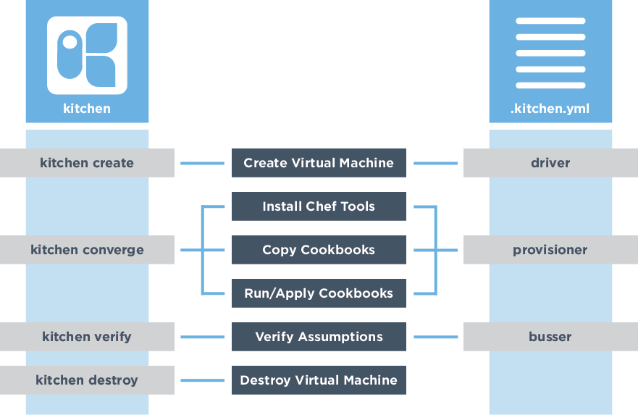
Test Kitchen's Configuration
Create Test Instance
Install Chef
Synchronize Cookbooks
Apply the Run List
Execute Tests

Slide 61
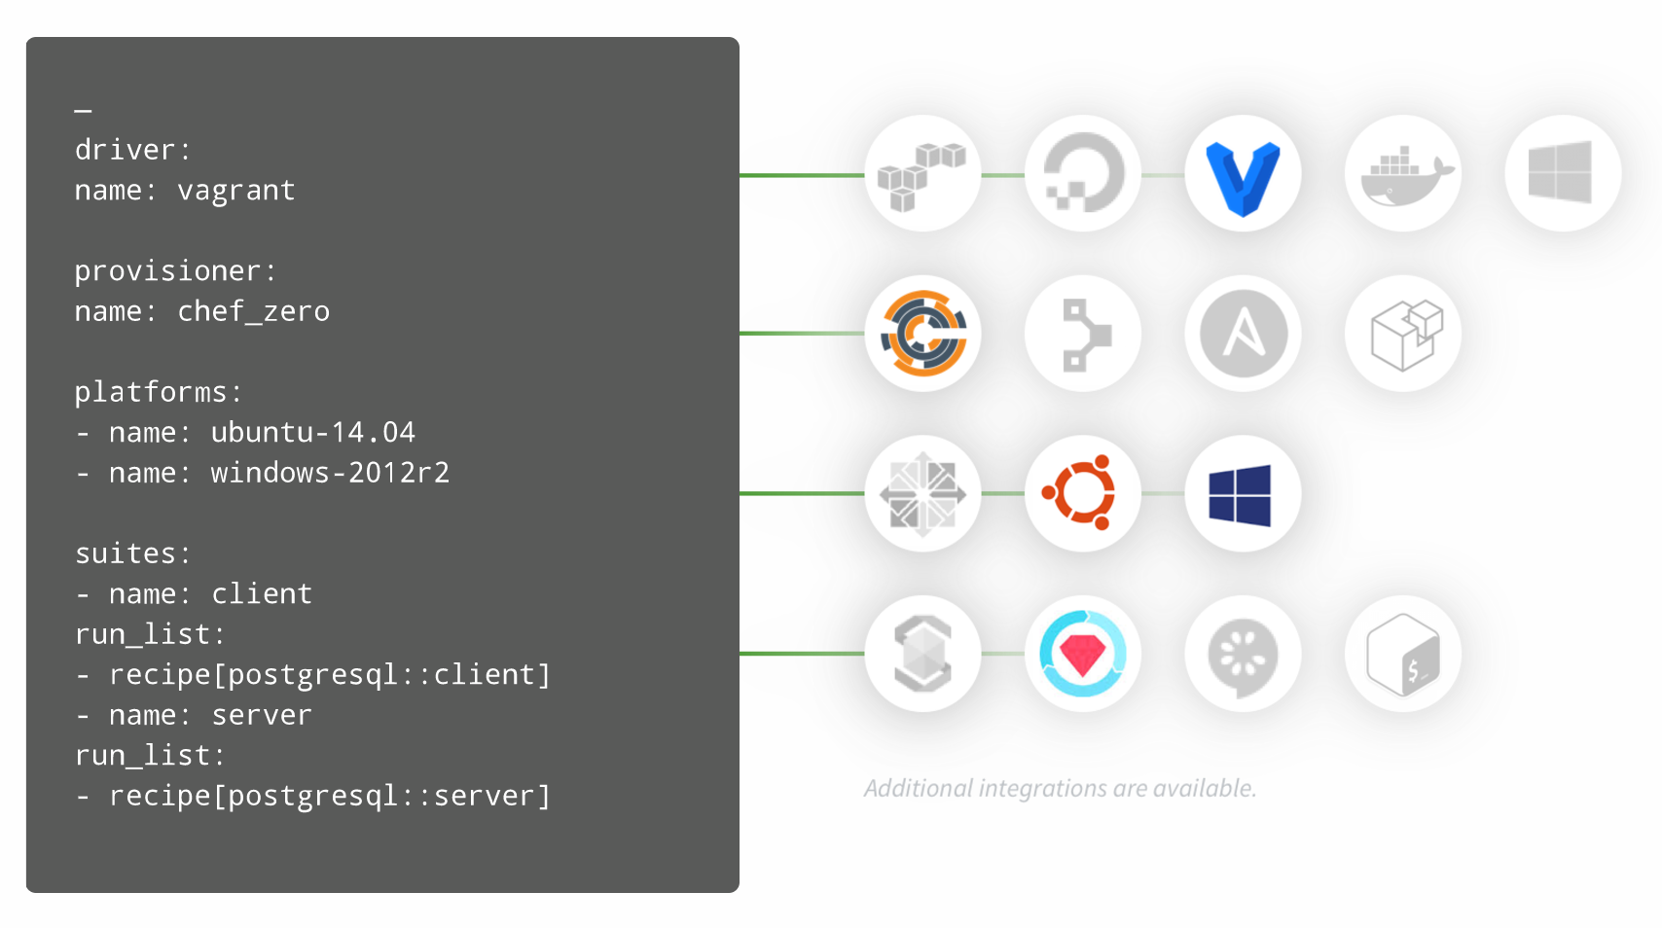

Test Kitchen's Configuration Makes it Versatile
kitchen.ci

Slide 62
Kitchen Dokken and InSpec
~/cookbooks/ruby_service/.kitchen.yml
driver:
name: dokken
provisioner:
name: dokken
transport:
name: dokken
verifier:
name: inspec

Slide 63
Kitchen Platforms and Test Suites
~/cookbooks/ruby_service/.kitchen.yml
platforms:
- name: centos-7
driver:
image: dokken/centos-7
privileged: true
pid_one_command: /usr/lib/systemd/systemd
volumes:
- /sys/fs/cgroup:/sys/fs/cgroup:ro # required by systemd
suites:
- name: default
run_list:
- recipe[specter_cookbook::default]
verifier:
inspec_tests:
- test/integration/default
attributes:

Slide 64
View the Test Matrix for Test Kitchen
> kitchen list
Instance Driver Provisioner Verifier Transport Last Action Last Error
default-centos-7 Dokken Dokken Inspec Dokken Converged <None>

Slide 65
Kitchen Platforms and Test Suites
~/cookbooks/ruby_service/.kitchen.yml
platforms:
- name: centos-7
driver:
image: dokken/centos-7
privileged: true
pid_one_command: /usr/lib/systemd/systemd
volumes:
- /sys/fs/cgroup:/sys/fs/cgroup:ro # required by systemd
suites:
- name: default
run_list:
- recipe[specter_cookbook::default]
verifier:
inspec_tests:
- test/integration/default
attributes:

Slide 66
Default Suite Test Files
~/cookbooks/ruby_service/test/integration/default/default_test.rb
# encoding: utf-8
# Inspec test for recipe ruby_service::default
# The Inspec reference, with examples and extensive documentation, can be
# found at http://inspec.io/docs/reference/resources/

Slide 67
Where do you write your tests
What tests do you write
How do we execute tests
Refactor

Slide 68
InSpec: command
Use the command InSpec audit resource to test an arbitrary command that is run on the system.
describe command('/usr/local/bin/ruby') do
it { should exist }
end
describe command('/usr/local/bin/ruby -v') do
its('stdout') { should match('2.5.1') }
end

Slide 69
InSpec: command
Use the command InSpec audit resource to test an arbitrary command that is run on the system.
describe command('curl http://localhost:8000') do
its('stdout') { should match('welcome friend') }
end

Slide 70
InSpec: host
Use the host InSpec audit resource to test the name used to refer to a specific host and its availability, including the Internet protocols and ports over which that host name should be available.
describe host('localhost', port: 8000, protocol: 'tcp') do
it { should be_reachable }
it { should be_resolvable }
end

Slide 71
InSpec: port
Use the port InSpec audit resource to test basic port properties, such as port, process, if it’s listening.
describe port(8000) do
it { should be_listening }
its('processes') {should include 'ruby'}
end

Slide 72
InSpec: http
Use the http InSpec audit resource to test an http endpoint.
describe http('http://localhost:8000', enable_remote_worker: true) do
its('status') { should eq 200 }
end

Slide 73
InSpec: service
Use the service InSpec audit resource to test if the named service is installed, running and/or enabled.
describe service('ruby_service') do
it { should be_installed }
it { should be_running }
end

Slide 74
Where do you write your tests
What tests do you write
How do we execute tests
Refactor

Slide 75
Execute the Tests
> kitchen verify
-----> Starting Kitchen (v1.20.0)
-----> Verifying <default-centos-7>...
Loaded tests from {:path=>".Users.franklinwebber.running_with_scissors.specter_cookbook.test.integration.default"}
Profile: tests from {:path=>"/Users/franklinwebber/running_with_scissors/specter_cookbook/test/integration/default"} (tests from {:path=>".Users.franklinwebber.running_with_scissors.specter_cookbook.test.integration.default"})
Version: (not specified)

Slide 76
Where do you write your tests
What tests do you write
How do we execute tests
Refactor

Slide 77
Chef: variables
A variable whose name begins with a lowercase letter (a-z) or underscore (_) is a local variable or method invocation.

Slide 78
Chef: attributes
An attribute is a specific detail about a node. Attributes are used by the chef-client to understand:
The current state of the node
What the state of the node was at the end of the previous chef-client run
What the state of the node should be at the end of the current chef-client run
https://docs.chef.io/attributes.html

Slide 79
Chef: include_recipe
https://docs.chef.io/dsl_recipe.html#include-recipes

Slide 80
Chef: include_recipe
~/cookbooks/ruby_service
> chef generate recipe ruby
https://docs.chef.io/dsl_recipe.html#include-recipes

Slide 81
Chef: include_recipe
~/cookbooks/ruby_service/recipes/default.rb
# ... other resources ...
include_recipe 'ruby'
# ... other resources ...
https://docs.chef.io/dsl_recipe.html#include-recipes

Slide 82
Chef: include_recipe
~/cookbooks/ruby_service/recipes/ruby.rb
# ... other resources ...
include_recipe 'ruby'
# ... other resources ...
https://docs.chef.io/dsl_recipe.html#include-recipes

Slide 83
Chef: Custom Resource
A custom resource is an extension of Chef that adds your own resources and is implemented and shipped as part of a cookbook.
~/cookbooks/ruby_service/recipes/default.rb
ruby_service_site 'specter' do
source 'specter.zip'
path '/srv'
end

Slide 84
Chef: Custom Resource
A custom resource is an extension of Chef that adds your own resources and is implemented and shipped as part of a cookbook.
~/cookbooks/ruby_service
> chef generate resource site

Slide 85
Chef: Custom Resource
A custom resource is an extension of Chef that adds your own resources and is implemented and shipped as part of a cookbook.
~/cookbooks/ruby_service/resources/site.rb
property :site_name, String, name_property: true
property :source, String, required: true
property :path, String, required: true
action :create do
# ...
end

Slide 86
Chef: Custom Resource
A custom resource is an extension of Chef that adds your own resources and is implemented and shipped as part of a cookbook.
~/cookbooks/ruby_service/resources/site.rb
action :create do
directory '/srv' do # ...
package 'unzip' # ...
cookbook_file '/srv/specter.zip' do # ...
execute 'extract_site' do # ...
end

Slide 87
Where do you write your tests
What tests do you write
How do we execute tests
Refactor

Slide 88
Challenge: First Web Service
Overview
Concepts
Exercise
Review

Slide 89
First Web Service
Converge the cookbook
Write tests for the cookbook
Execute the tests
Assist, Break it, Explore or Refactor
Write at least one test that give you the confidence that the site is working.

Slide 90
Challenge: First Web Service
Overview
Concepts
Exercise
Review

Slide 91
Live Demonstration

Slide 92
Challenge: First Web Service
Overview
Concepts
Exercise
Review

Slide 93
Break

Slide 94
Challenge: Second Web Service
Overview
Concepts
Exercise
Review

Slide 95
Web Service
The web service launches a website that accepts JSON payloads.
GET http://localhost:8000/scans
POST http://localhost:8000/scans with JSON payload
GET http://localhost:8000/scans/ID
DELETE http://localhost:8000/scans/ID

Slide 96
JavaScript/Node Implementation
Node 9.5.0
npm
node

Slide 97
Challenge: Second Web Service
Overview
Concepts
Exercise
Review

Slide 99
Challenge: Second Web Service
Overview
Concepts
Exercise
Review

Slide 100
Second Web Service
Converge the cookbook
Write tests for the cookbook
Execute the tests
Assist, Break it, Explore or Refactor
Write at least one test that give you the confidence that the site is working.

Slide 101
Challenge: Second Web Service
Overview
Concepts
Exercise
Review

Slide 102
Live Demonstration

Slide 103
Challenge: Second Web Service
Overview
Concepts
Exercise
Review

Slide 104
Break

Slide 105
Challenge: Re-use with InSpec Profiles
Overview
Concepts
Exercise
Review

Slide 106
Test Duplication
Both of these web services share a common interface even if the implementation differs. If a third implementation of the site were to appear you would find yourself repeating yourself again.

Slide 107
Challenge: Re-use with InSpec Profiles
Overview
Concepts
Exercise
Review

Slide 108
Initializing an InSpec profile
Using a InSpec profile within Test Kitchen
Conditionally executing controls

Slide 109
Challenge: Re-use with InSpec Profiles
Overview
Concepts
Exercise
Review

Slide 110
Re-use with InSpec Profiles
Initialize an InSpec profile
Populate the InSpec profile with your controls
Set framework specific controls as conditional
Both web service cookbooks are verified by an InSpec profile

Slide 111
Challenge: Re-use with InSpec Profiles
Overview
Concepts
Exercise
Review

Slide 113
Challenge: Re-use with InSpec Profiles
Overview
Concepts
Exercise
Review

Slide 114
Break

Slide 115
Challenge: Third Web Service
Overview
Concepts
Exercise
Review

Slide 116
Web Service
The web service launches a website that accepts JSON payloads.
GET http://localhost:8000/scans
POST http://localhost:8000/scans with JSON payload
GET http://localhost:8000/scans/ID
DELETE http://localhost:8000/scans/ID

Slide 117
Rust Application
rust
rustup (nightly releases)
cargo
diesel-cli

Slide 118
Challenge: Third Web Service
Overview
Concepts
Exercise
Review

Slide 119
Initializing an InSpec profile
Using a InSpec profile within Test Kitchen
Conditionally executing controls

Slide 120
Challenge: Third Web Service
Overview
Concepts
Exercise
Review

Slide 121
Third Web Service
Converge the cookbook
Write tests in the cookbook or in the profile
Execute the tests
Assist, Break it, Explore or Refactor
Write at least one test that give you the confidence that the site is working.

Slide 122
Challenge: Third Web Service
Overview
Concepts
Exercise
Review

Slide 123
Live Demonstration

Slide 124
Challenge: Third Web Service
Overview
Concepts
Exercise
Review

Slide 125
Break

Slide 126
Challenge: Audit Cookbook
Overview
Concepts
Exercise
Review

Slide 127
Scanning on Converge
Ensure that your tests work during development and in production.

Slide 128
Challenge: Audit Cookbook
Overview
Concepts
Exercise
Review

Slide 129
audit cookbook (and its attributes)
wrapper cookbook pattern
Chef.event_handler (12.5)
chef_handler (external cookbook or chef-client 14.0)
testing it with test kitchen

Slide 130
# @see https://github.com/chef-cookbooks/audit
node.default['audit'] = { 'reporter' => 'json-file', 'interval' => { 'enabled' => false }, 'profiles' => [ # TODO: A profile that looks the one that they developed but on the web # TODO: their profile zipped up and stored into the cookbook { "name" => "linux-baseline", "supermarket" => "dev-sec/linux-baseline" } ]}

Slide 131
Using Chef.event_handler - bash
# @see https://docs.chef.io/dsl_handler.htmlChef.event_handler do on :run_completed do # BASH Solution scan_path = "#{Chef::Config[:cookbook_path]}/audit/inspec-*.json" puts `curl -d @$(find . -name #{scan_path}) -H "Content-Type: application/json" http://localhost:8000/scans` # ShellOut Solution upload = Mixlib::ShellOut.new "curl -d @$(find . -name #{scan_path}) -H 'Content-Type: application/json' http://localhost:8000/scans" upload.run_command # Ruby/Chef Solution connection = Chef::HTTP.new('http://localhost:8000') headers = { 'Content-Type' => 'application/json' } Dir["#{Chef::Config[:cookbook_path]}/audit/inspec-*.json"].each do |scan_file| data = File.read(scan_file) connection.post("/scans", data.to_s, headers) end endend

Slide 132
Using Chef.event_handler - shell_out
# @see https://docs.chef.io/dsl_handler.htmlChef.event_handler do on :run_completed do # BASH Solution scan_path = "#{Chef::Config[:cookbook_path]}/audit/inspec-*.json" puts `curl -d @$(find . -name #{scan_path}) -H "Content-Type: application/json" http://localhost:8000/scans` # ShellOut Solution upload = Mixlib::ShellOut.new "curl -d @$(find . -name #{scan_path}) -H 'Content-Type: application/json' http://localhost:8000/scans" upload.run_command # Ruby/Chef Solution connection = Chef::HTTP.new('http://localhost:8000') headers = { 'Content-Type' => 'application/json' } Dir["#{Chef::Config[:cookbook_path]}/audit/inspec-*.json"].each do |scan_file| data = File.read(scan_file) connection.post("/scans", data.to_s, headers) end endend

Slide 133
Using Chef.event_handler - ruby/chef
# @see https://docs.chef.io/dsl_handler.htmlChef.event_handler do on :run_completed do # BASH Solution scan_path = "#{Chef::Config[:cookbook_path]}/audit/inspec-*.json" puts `curl -d @$(find . -name #{scan_path}) -H "Content-Type: application/json" http://localhost:8000/scans` # ShellOut Solution upload = Mixlib::ShellOut.new "curl -d @$(find . -name #{scan_path}) -H 'Content-Type: application/json' http://localhost:8000/scans" upload.run_command # Ruby/Chef Solution connection = Chef::HTTP.new('http://localhost:8000') headers = { 'Content-Type' => 'application/json' } Dir["#{Chef::Config[:cookbook_path]}/audit/inspec-*.json"].each do |scan_file| data = File.read(scan_file) connection.post("/scans", data.to_s, headers) end endend

Slide 134
Adding a dependency on chef_handler
metadata.rb
name 'azrael'maintainer 'The Authors'maintainer_email 'you@example.com'license 'All Rights Reserved'description 'Installs/Configures azrael'long_description 'Installs/Configures azrael'version '0.1.0'chef_version '>= 12.14' if respond_to?(:chef_version)depends 'audit'depends 'chef_handler'

Slide 135
Using the chef_handler resource
# @see https://docs.chef.io/resource_chef_handler.html
chef_handler 'Azrael::Handler::UploadFile' do source "#{Chef::Config[:cookbook_path]}/#{cookbook_name}/files/default/upload_handler.rb" arguments [ server: 'http://localhost:8000' ] supports report: true, exception: true action :enableend

Slide 136
Adding to the cookbook Berksfile
Berksfile
# frozen_string_literal: truesource 'https://supermarket.chef.io'metadatacookbook 'azrael', path: '../azrael'

Slide 137
Adding a new test suite
.kitchen.yml
suites: - name: default run_list: - recipe[node_service::default] verifier: inspec_tests: - ../../web_service attributes: - name: scan run_list: - recipe[node_service::default] - recipe[azrael::default] verifier: inspec_tests: - test/integration/default attributes:

Slide 138
Test the upload / results
cookbooks/COOKBOOK/test/integration/scan/default_test.rb
# encoding: utf-8# REFERENCE# https://inspec.io/docs/reference/resources/command# https://inspec.io/docs/reference/resources/host# https://inspec.io/docs/reference/resources/port# https://inspec.io/docs/reference/resources/service# https://inspec.io/docs/reference/resources/file/describe file('/upload-response.txt') do it { should exist } its('content') { should_not match /FAILED TO CONTACT http:\/\/localhost:8000/ }end# https://inspec.io/docs/reference/resources/http/describe json(command: 'curl http://localhost:8000/scans') do its('count') { should > 1 } its(['last']) { should cmp '1.42.3' } its(['last','data']) { should cmp '1.42.3' } its(['last','data','version']) { should cmp '1.42.3' }end

Slide 139
Challenge: Audit Cookbook
Overview
Concepts
Exercise
Review

Slide 140
Audit Cookbook
Add a dependency on the cookbook
Add a new test suite that installs the service and scans
Define the attributes within the wrapper recipe
Use Chef.event_handler or chef_handler
Test that the scan completed and uploaded
The scan completes successfully and is verified by a test

Slide 141
Challenge: Audit Cookbook
Overview
Concepts
Exercise
Review

Slide 142
Live Demonstration

Slide 143
Challenge: Audit Cookbook
Overview
Concepts
Exercise
Review

Slide 144
Break

Slide 145
Challenge: A Web Service in Habitat
Overview
Concepts
Exercise
Review

Slide 146
Patterns
In all of the web services we identified a pattern:
* Install the framework
* Copy the source
* Install dependencies
* Migrate the database
* Create / Start a service

Slide 147
Challenge: A Web Service in Habitat
Overview
Concepts
Exercise
Review

Slide 148
Generate a habitat plan
Habitat scaffolding
Habitat Studio
Build, Run, Export
InSpec Profiles testing Habitat

Slide 149
Challenge: A Web Service in Habitat
Overview
Concepts
Exercise
Review

Slide 150
A Web Service in Habitat
Generate a habitat plan and modify it as necessary
Enter the Habitat studio, build, run and export
Generate a Habitat artifact for the Service
Run the service artifact and the profile artifact
The Habitat supervisor is running the service artifact and profile artifact.

Slide 151
Challenge: A Web Service in Habitat
Overview
Concepts
Exercise
Review

Slide 152
Live Demonstration

Slide 153
Challenge: A Web Service in Habitat
Overview
Concepts
Exercise
Review

Slide 154
Break

Slide 155
Summary / Wrap-Up

Slide 156
Resources - Chef

Slide 157
Resources - InSpec

Slide 158
Resources - Habitat

Slide 159
Conference Schedule

Slide 160
Schedule Suggestion

Slide 161
Learn Chef Rally Booth

